Slide 1
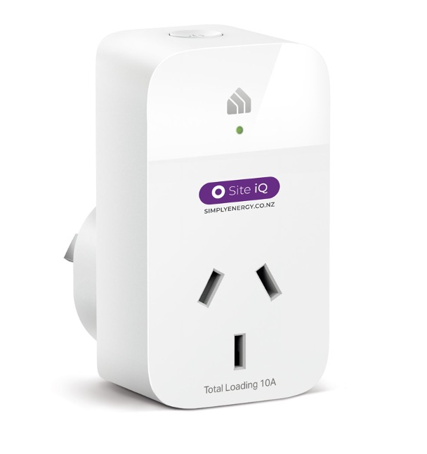
Site iQ Quick Guide
Keeping things running smoothly
How to read the plug status light
Each plug has a small light on the front to show its status. When the plug operates correctly, the light will glow a solid green. Follow the steps below if it’s flashing or there’s no light.
A few other things to keep things humming
The plugs are location-specific and need to remain connected, so please:
don’t unplug equipment from them,
turn them off,
unplug them; or,
move them.
OFF/ON BUTTON
Light
Meaning
Action
STATUS LIGHT
None
Solid
Operating correctly
Flashing
Not operating correctly
Contact <name>
No light
No power
First, check that the main power is on and that the plug and device are connected correctly. Then briefly* press the button on the top of the plug to turn it on. If the light turns on but isn’t green contact <name>
* Pressing the button for too long (more than 5 seconds) resets the plug. If this happens contact <name>.
[Your Logo]

